Slide 1
AI on Complex 3D Surfaces
Nick Miller, Trevor Harron, Charles Boudousquie
7/14/19

Slide 2
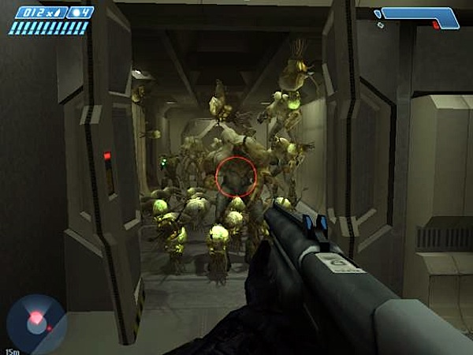
Notes:
For this project we used Unity and C# scripting The reason we used Unity was to leverage the built in mesh capabilities as well as the powerful c# scripting for the behaviors and Algorithms

Slide 3
Goal
Implement agents that can efficiently navigate the surface of any 3D model
Notes:
outline need (striking agent behavior)
give goal (implement)
*calling it gecko ai

Slide 4
Gecko AI in three steps
Generate the Navmesh
Adapt the Funnel Algorithm
Implement Agent Behavior

Slide 5
The Nav Mesh
Notes:
Before we get to the 3D Funneling, we need to have a navmesh that allows us to navigate a complex shape.
Most navmeshes like the one unity can generate are designed for 2D Funneling and a (generally) flat 2.5D navigable surface
So we built our navmesh based on the Unity Mesh object and comprised that mesh of nodes containing the needed positional and directional information
This allowed us to ensure not only the correct movement of the agents but also give us the needed information for terrain analysis The Terrain analysis simply analyzes the players postions and the camera direction reletive to each node to determine the node visability and distance

Slide 6
Understanding the funnel algorithm
How does one funnel?
Notes:
start with a navmesh path,
form a ‘funnel’ between the starting point and the first two shared points in the path
check if the next point is within the funnel
if it is, ‘reduce’ the funnel by re-assigning one of the path’s points
if it isn’t, add the newest point to the list of efficient path points and re-initialize the funnel

Slide 7
Funneling application: Voronoi mesh
[image of fucked up 3d path]
Notes:
describe my process for extrapolating in 3d

Slide 8
Extrapolating the funnel algorithm
[fade in/out of steps in one slide]
Notes:
note normal of starting node, visualize it as a dotted line
select shared points like with funnel algorithm
take difference of (funnel boundary) and (closest point on normal line to funnel boundary)
use these points to define a ‘funnel’ with planes
check if next point is within the funnel using similar vector
continue as if normal funnel algorithm

Slide 9
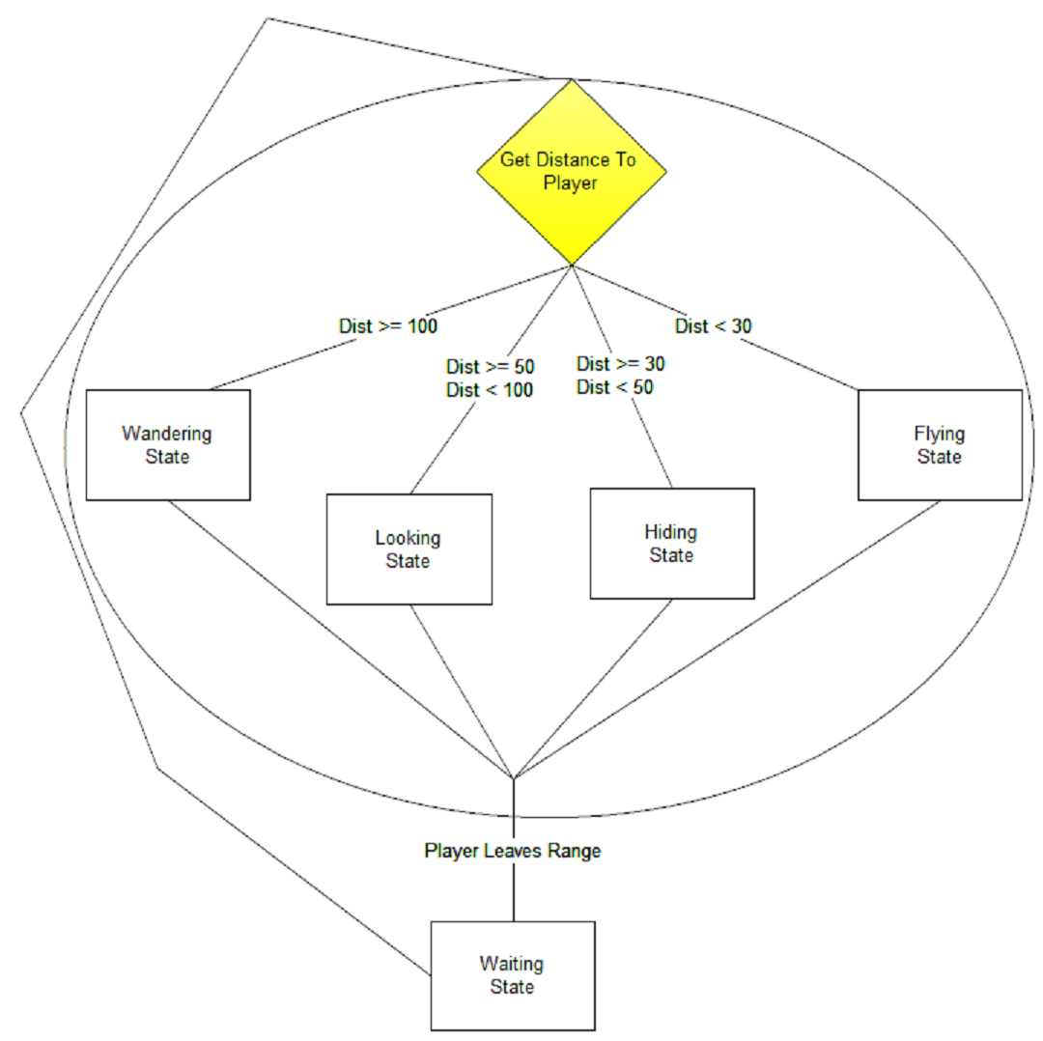
Behavior Design
Notes:
First the fly starts off in the waiting state. Then it checks to see how far it is away from the player. Behavior is chosen based on distance.
Enemy will continue action until the distance to the player reaches a different range.

Slide 10
Terrain analysis can free up resources

Slide 11
Seeing is believing
Demo

Slide 12
Practical uses of 3D Funneling

Slide 13
Questions/Comments

